Slide 1
NEXTHIKES IT SOLUTION
PROJECT – 3
“Exploratory Data Analysis (EDA) for Real Estate
pricing”
“Unveiling the Dynamics of House Valuation in a
Dynamic Market”
Mahak Goyal

Slide 2

Title: Introduction
Objective:
The primary purpose of this Exploratory Data Analysis (EDA) is to uncover valuable insights from the real estate dataset that can significantly inform house pricing strategies.
By analyzing and understanding the relationships between various key factors such as location, amenities, size, and market trends, we aim to guide better decision-making in property valuations.
Goal:
To systematically explore how different variables (e.g., location, square footage, number of bedrooms, amenities, etc.) impact house prices.
The insights gained will help adjust pricing strategies, enhance customer satisfaction, and help position properties effectively in the competitive real estate market.

Slide 3
Title : Dataset Overview
Content:
Source: The data has been sourced from real estate transactions and includes various attributes associated with properties sold in the market.
Scope: This dataset is focused on residential real estate and covers a wide range of factors that influence house pricing.
Key Features:
SalePrice: The target variable representing the house's final sale price.
Bedrooms: The number of bedrooms in the house.
Bathrooms: The number of bathrooms in the house.
SquareFootage: The total area of the house (measured in square feet).
Location: The neighborhood or area where the property is situated (could be a
categorical variable).
LotArea: The size of the property’s lot (in square feet).

Slide 4
Title: Data Cleaning
Handling Missing Values:
The dataset had [number of missing values] missing entries across different variables.
Imputation: We used techniques such as mean/mode imputation for numerical columns and mode imputation for categorical columns, where appropriate.
For certain variables with excessive missing data, we decided to remove those columns to prevent bias.
Removing Duplicates:
The dataset contained [number of duplicates] duplicate rows.
We removed duplicates to ensure the integrity of the analysis and avoid skewing results.

Slide 5
Visuals:
1.Histogram Plot
2. Violin Plot
3. Bar Plot
4. Scatter Plot
5. KDE Plot
6. Open GL Surface Plot
7. Glyph Plot
8. Box plot
9. Parallel Coordinates Plot
10. Stacked Bar Plot
11. Pair plot
12. Heatmaps

Slide 6
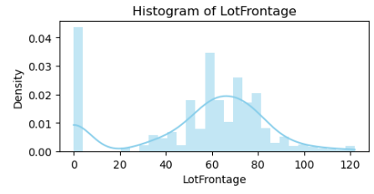
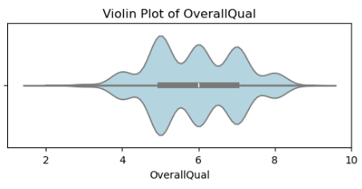
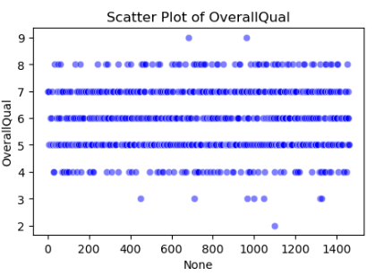
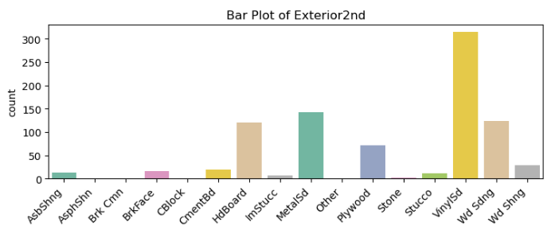
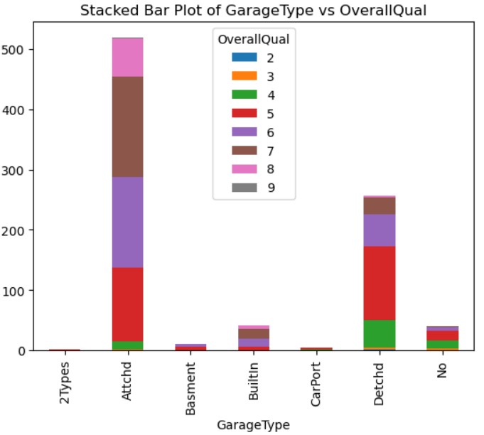
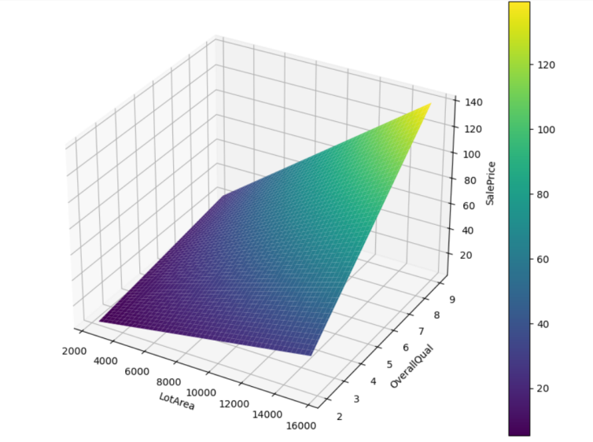
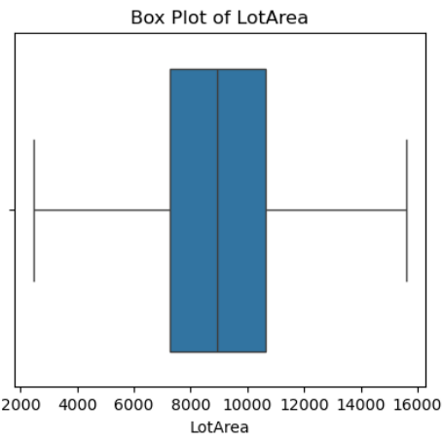
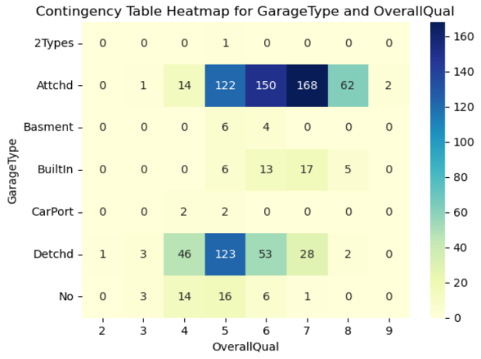

Slide 7
Univariate Analysis: House Price Distribution :
The SalePrice is one of the most critical variables in real estate analysis. It provides the final valuation of a house, influenced by various factors such as size, quality, location, and amenities. In univariate analysis, we focus on the distribution of this variable to understand its characteristics like skewness, range, and outliers. Understanding this distribution can help in determining the overall trends in house prices and give insights into potential price points in the market.
Key Insights:
Skewness: House prices tend to be right-skewed, with more houses having lower prices and a few very high-value properties pulling the average up.
Range: The house prices vary significantly, with both low-priced homes and high-priced luxury properties in the market.
Outliers: A few extremely high-priced properties may appear as outliers on the plot, which could represent unique cases or luxury properties.

Slide 8
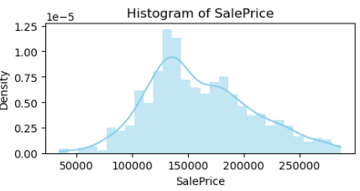
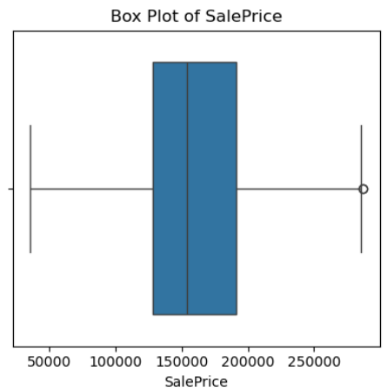
Visuals:
Histogram: Displays the frequency of house prices in different price ranges, showing how prices are distributed across the dataset.
Boxplot: Highlights the distribution, identifying the median, interquartile range (IQR), and potential outliers.
The boxplot gives a summary of the central tendency (median), spread (IQR), and outliers . The "whiskers" extend to the range of the data, and any points outside of the whiskers are considered outliers (potentially high-priced houses).
The histogram shows how SalePrice is distributed across the dataset.
A right-skewed distribution is typically observed, where most houses fall within a lower price range, while a few properties extend into the higher price range.

Slide 9
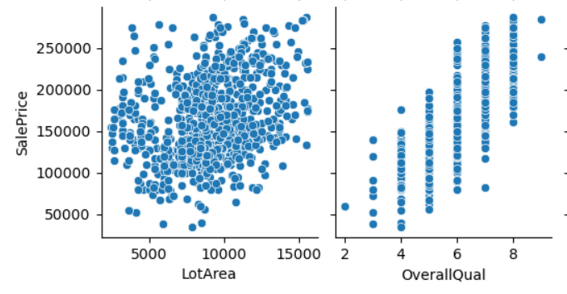
Multivariate Analysis: Relationships with House Prices
Bivariate analysis examines the relationship between SalePrice and a single feature at a time, allowing us to identify how each feature individually impacts house prices. By focusing on pairs of variables, we can discern both linear and non-linear patterns that may not be evident in a multivariate context.
Visuals:
Scatter Plot:
SalePrice vs. Overall Quality: Demonstrates a strong positive correlation.

Slide 10

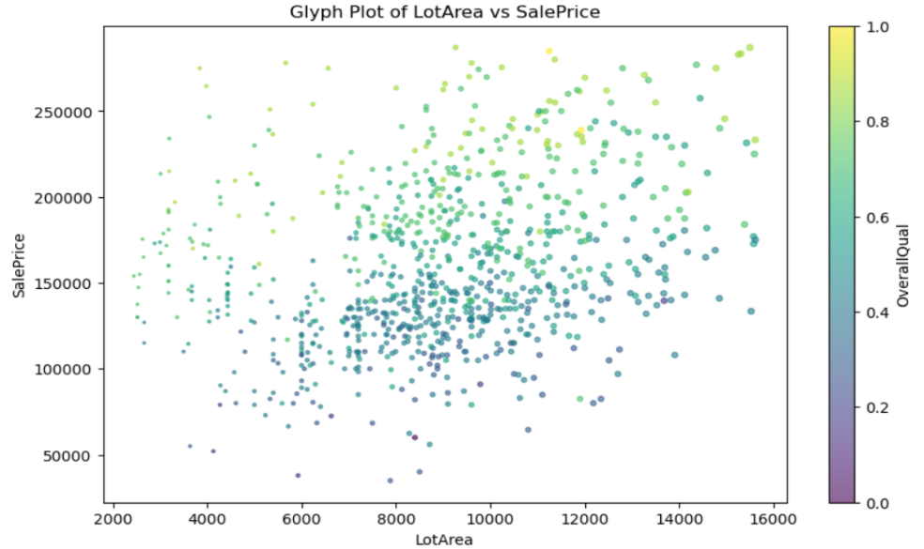
Multivariate Analysis: Insights into House Price Determinants
Multivariate analysis explores the combined effects of multiple features on SalePrice. It helps to identify which variables interact with each other and how they collectively influence the price of a house. This analysis reveals the relative importance of various factors and how they work together.
Visuals:
Open GL Surface Plots Glyph Plot

Slide 11
Feature Engineering: Enhancing House Price Analysis
Feature engineering involves creating new variables that can better capture important patterns in the data. Two key new features that can enhance the analysis of house prices are:
Age-related features:
AgeOfHouse: The age of the house calculated as the difference between the current year and the year the house was built (YearBuilt).
RenovationAge: The age of the renovation calculated as the difference between the current year and the year the house was remodeled (YearRemodAdd).
Basement-related features:
TotalBasementArea: Sum of the finished and unfinished basement areas, providing a more comprehensive measure of the total basement size.
HasBasement: A boolean feature indicating whether the house has a basement. It’s True (1) if the BsmtQual (basement quality) is not null.
Interaction features:
LotFrontage_LotArea: Interaction between LotFrontage (the length of the property’s frontage) and LotArea (the size of the lot). This interaction can help capture how lot dimensions impact house pricing.

Slide 12
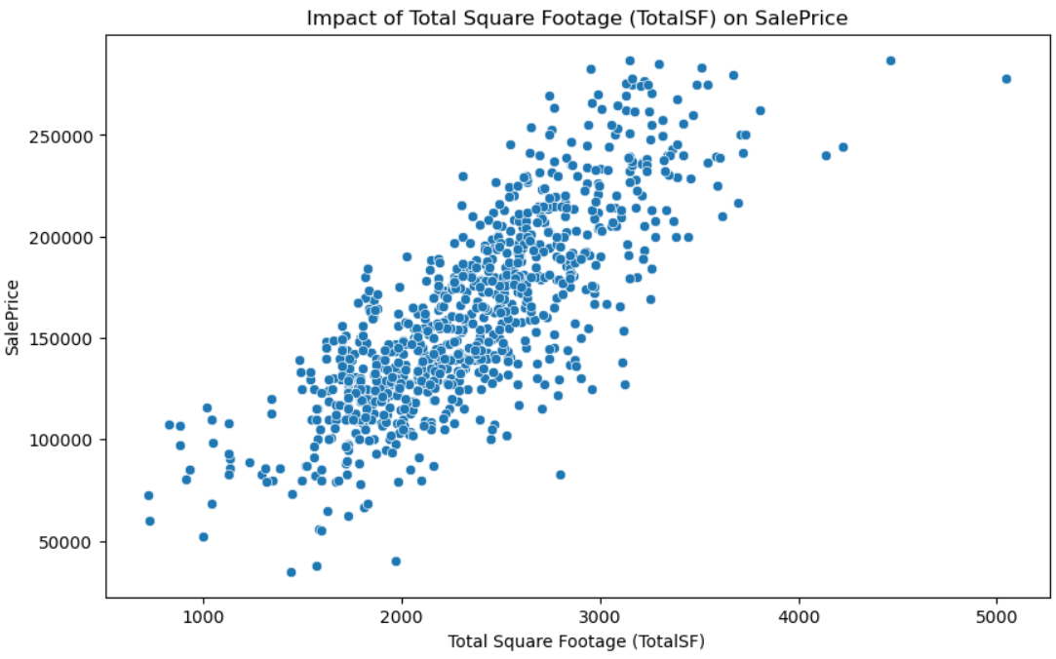
Impact of Features and Size on House Prices
When analyzing house prices, certain features like the number of bedrooms, bathrooms, and square footage (both living area and basement area) have a direct impact on the value of a property. The following features are often key indicators of house price:
Number of Bedrooms: More bedrooms generally increase the property's value as they provide more living space.
Number of Bathrooms: A higher number of bathrooms often increases the convenience and appeal of the house, thereby raising its value.
Square Footage: Larger properties tend to have higher values, as more space correlates with a higher price.
Basement Area: Larger basements may also increase a house’s value, especially if the basement is finished or usable.
Visuals:
Scatter plot: This plot will show how
the combined square footage (living
area + basement area) correlates
with the house price.

Slide 13
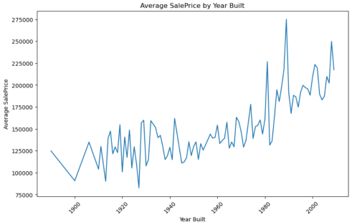
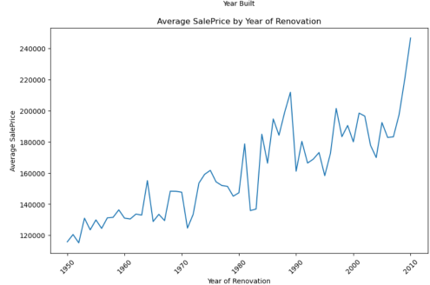
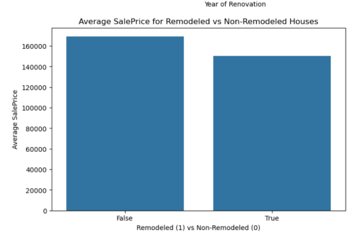
Market Trends and Historical Pricing :
Understanding how house prices have evolved over time is crucial for assessing the overall health of the real estate market. By examining historical trends, we can gain insights into:
The overall market growth and fluctuations in property values.
The impact of economic factors such as inflation, interest rates, and external events.
Price stability or volatility over the years, helping predict future trends.
Visuals:
Line plot of Average Sale Price by Year Built: This plot will help you see if the prices of houses built in different years show an increasing or decreasing trend.
Line plot of Average Sale Price by Year of Renovation: This will provide insights into how the renovation of homes influences the pricing trend over the years.
Bar plot of Average Sale Price for Remodeled vs Non-Remodeled Houses: This shows how remodeling impacts house prices, likely showing higher prices for remodeled homes.

Slide 14
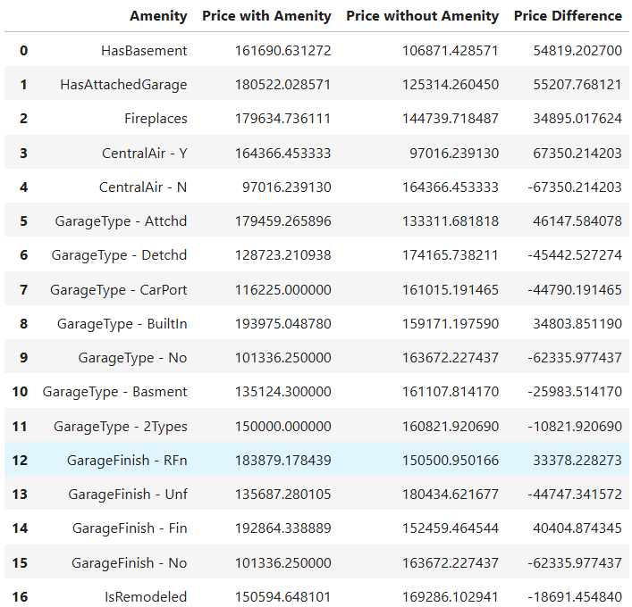
Impact of Customer Preferences and Amenities on House Prices:
Key Points :
Features such as garages, fireplaces, and basements are essential in determining the price of a home.
We will explore the price difference between homes with and without these amenities.
Understanding these impacts can help target specific amenities to enhance pricing strategies.
Visualization:
The final part of your code creates a bar plot
that compares the sale prices for homes with
and without each amenity. You color the bars
differently for a clear comparison.

Slide 15
Reference:
Exploratory Data Analysis in Python | Set 1 – GeeksforGeeks
https://analyticslearn.com/exploratory-data-analysis-eda-in-python-ultimate-guide
Exploratory Data Analysis (EDA) - How to do EDA for Machine Learning Problems using Python – MLPlus
Detailed Guide to Exploratory Data Analysis (EDA) in ML | Upskill Campus

